Slide 1

Pragmatic analysis
Mdsa01 – May 17, 2018

Slide 2

Reality Vs. Media Reality Satire and Fake News

Slide 3
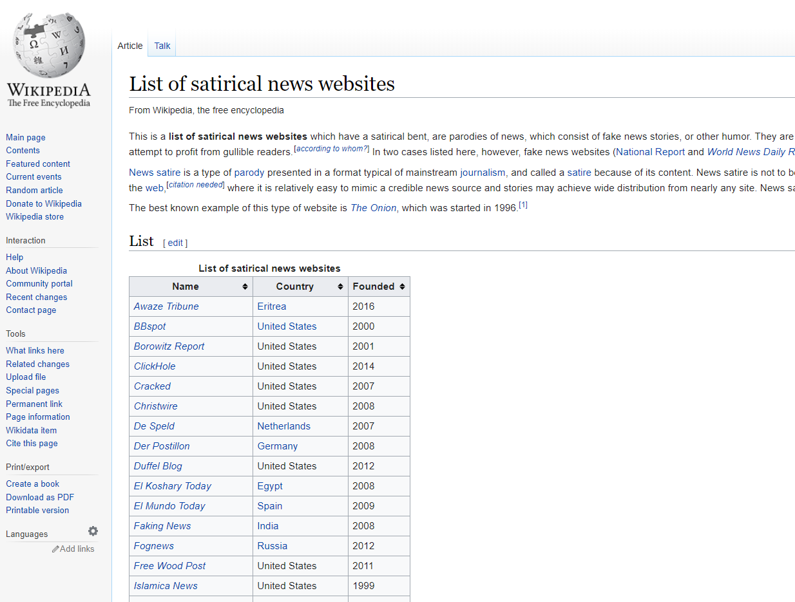
Blurring Reality
https://en.wikipedia.org/wiki/List_of_satirical_news_websites

Slide 4
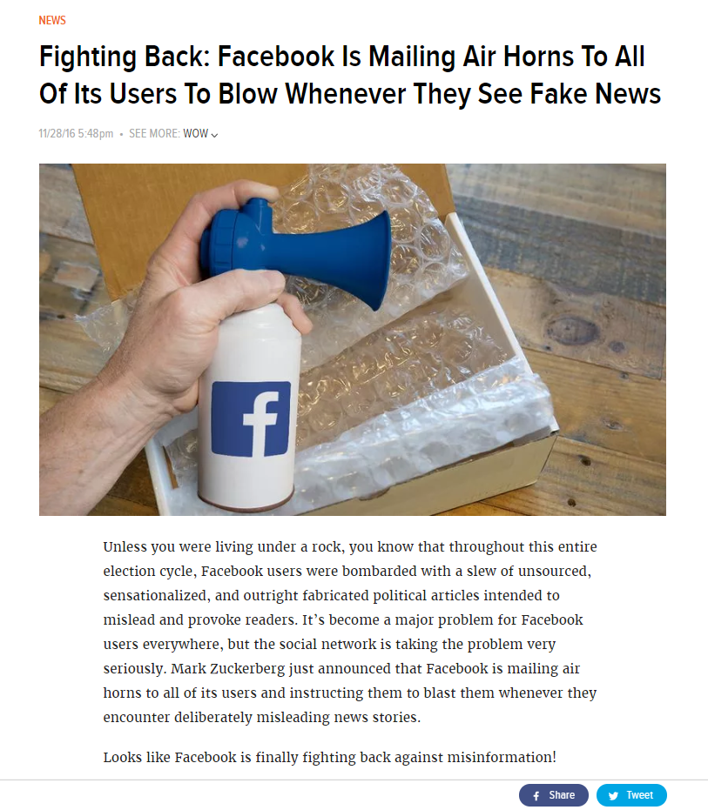
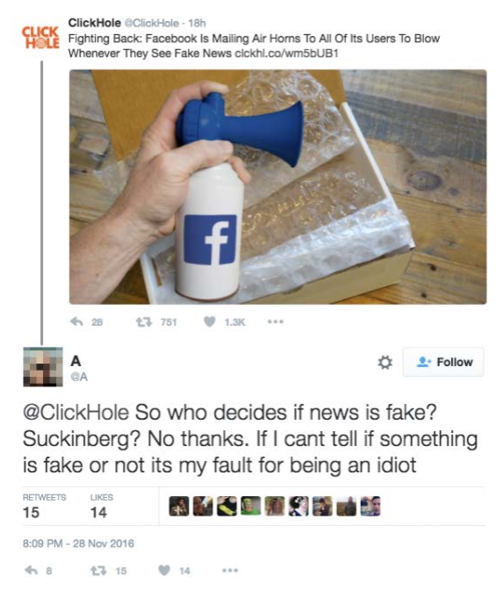
https://news.clickhole.com/fighting-back-facebook-is-mailing-air-horns-to-all-of-1825122264

Slide 5
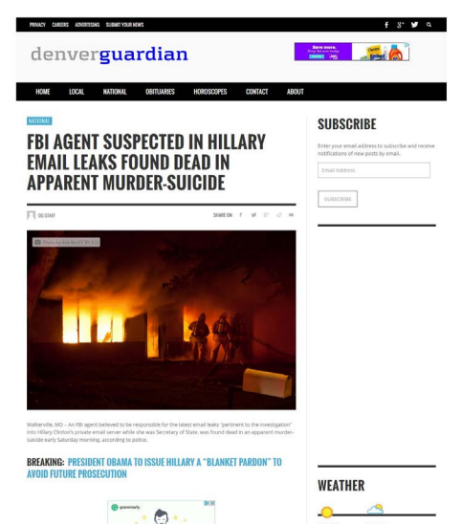
There Is No Such Newspaper As The “Denver Guardian” “Story” ran 3 days before the U.S. presidential election

Slide 6
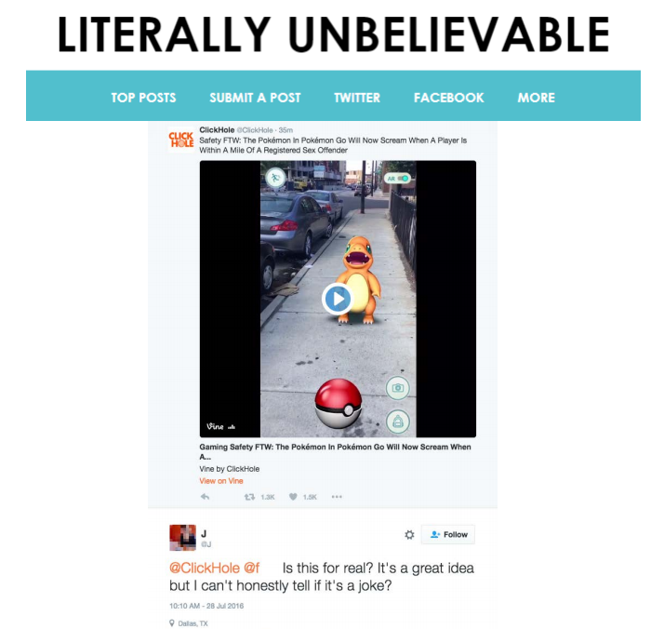
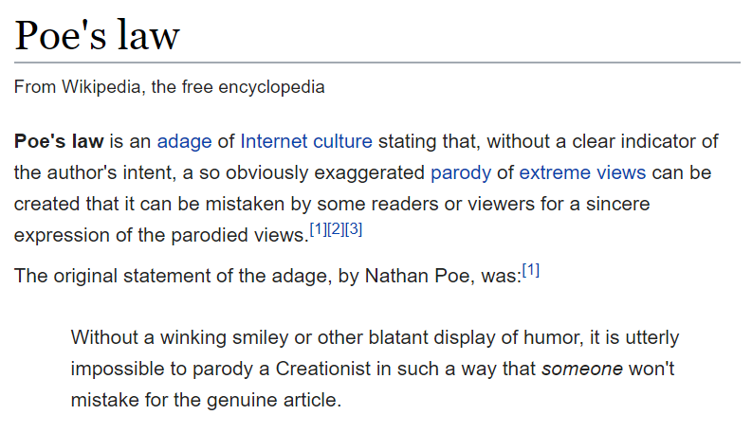
Poe’s Law
https://en.wikipedia.org/wiki/Poe%27s_law
http://literallyunbelievable.org/

Slide 7
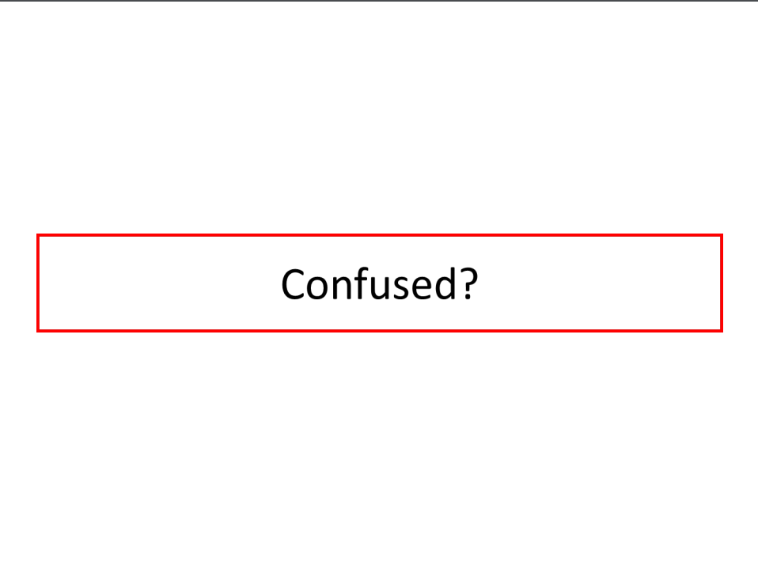

Slide 8
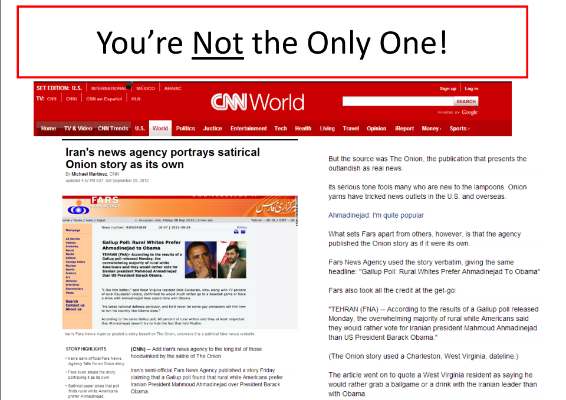

Slide 9

Pragmatic Analysis
Practicality
Legislation
Regulation

Slide 10
Orienting questions
Should media be regulated? If so, how?
What are the consequences and contingencies involved in regulation?
What is the most practical resolution to a problem?

Slide 11
what
PRIMARY QUESTION FOR ALL PRAGMATIC ANALYSIS
should
we
do
about
It??

Slide 12
Definition: Pragmatism
“Pragmatism is a branch of philosophy that assesses truth in terms of effect, outcome, and practicality. Unlike earlier metaphysical philosophers, who viewed truth as a transcendental constant waiting to be discovered, Pragmatists claim that truth depends on the degree to which a concept or theory provides us with useful results in the process of solving problems” (Ott and Mack 82).

Slide 13

Contra metaphysics
Metaphysics:
Study of being and existence (ontology) and the world (cosmology)
What is the meaning of life? What does it mean to be?
M81 spiral galaxy
Image source: http://www.nasa.gov

Slide 14
Principles of Metaphysics
Truth is transcendent, constant, universal
Truth is “out there” waiting to be discovered
Truth can never be fully known
Longstanding debates:
● mind/body
● free will/determinism
http://en.wikipedia.org/wiki/Mind%E2%80%93body_problem
http://en.wikipedia.org/wiki/Dualism_(philosophy_of_mind)
http://en.wikipedia.org/wiki/Neuroscience_of_free_will
http://news.stanford.edu/news/2011/september/compatibilism-perry-philosophy-091511.html

Slide 15
Interesting Questions!
But these are not Pragmatic Questions!

Slide 16
Pragmatism
Practicality
What works? What doesn’t work? Why?
What improvements can be made?
“The whole function of philosophy ought to be to find out what definite difference it will make to you and me at definite instants of our life, if this world formula or that world formula be the true one.”
- William James (1842-1910)

Slide 17
Capital-T truth
Truth can be debated forever (metaphysics)
truth is local, contingent, contextual, historical and therefore we need to:
Problem solve
Assess outcomes/effect
Measure and produce tangible results and benefits
Examine and rationalize consequences
BE PRAGMATIC!

Slide 18
Three key pragmatists
William james,
John dewey,
Richard rorty

Slide 19
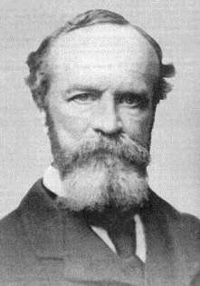
William James (1842-1910)
Individual and “Habit”
“Habit” = “a pathway of discharge formed in the brain, by which certain incoming currents ever after tend to escape” (Ott and Mack 83)
Note: Alcoholics Anonymous
Radical empiricism
“…the only things that shall be debatable among philosophers shall be things definable in terms drawn from experience.”

Slide 20
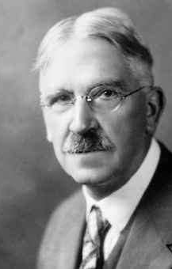
John Dewey (1859-1952)
Focus on society and larger social issues.
Educational reformer: against rote memorization
Problem-solving skills
Productive and responsible citizens
Pragmatic Meliorism

Slide 21
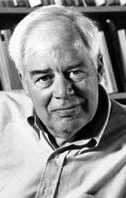
Richard Rorty (1931-2007)
Relativism – “the belief that diverse approaches and theories related to a given subject are all equally correct” (Ott and Mack 85)
Rejection of capital-T Truth
Restricted relativism
Social situation and placement in history
Ironism – a commitment to seeing the world in terms of contingent historical conditions

Slide 22
Media Regulation: A Pragmatic Paradigm
Consequences – Effects of regulations
Contingencies – Factors at play during the creation of a regulation
Tensions:
“Public Interest”
vs.
“Free Market”
Government (or business) regulation vs. media self-regulation

Slide 23
Example: Regulating media content
Native advertising

Slide 24


Example: Regulating media content

Slide 25
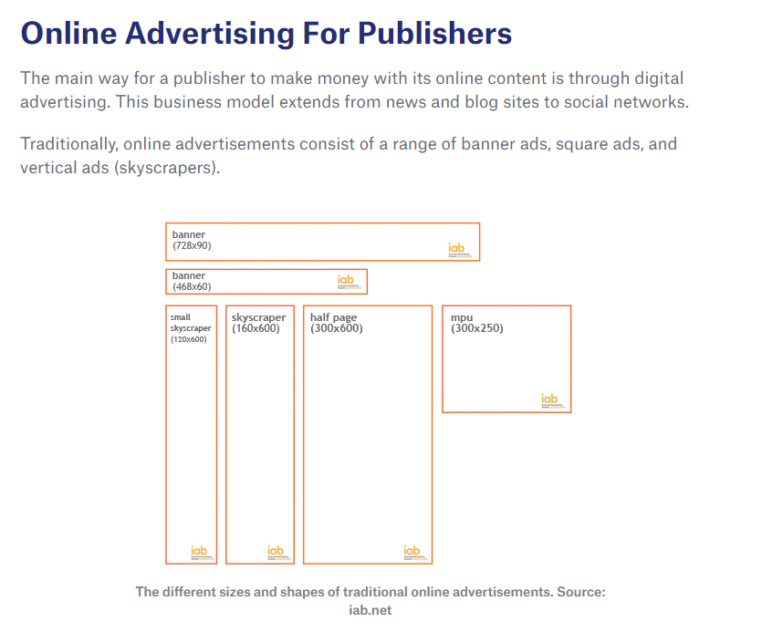
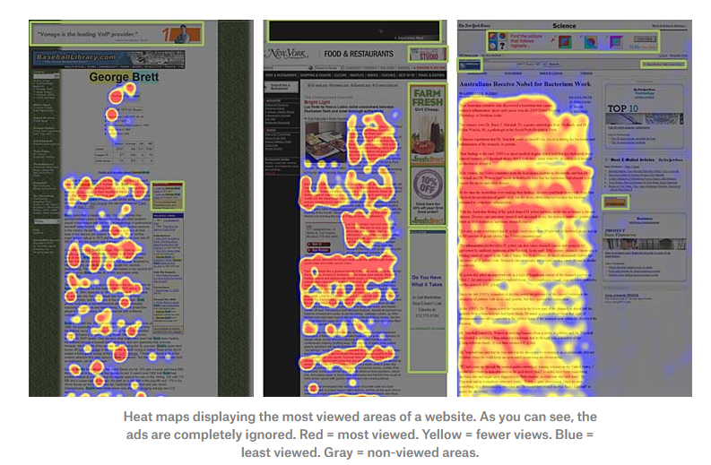
“Banner Blindness”

Slide 26

Native Advertising

Slide 27
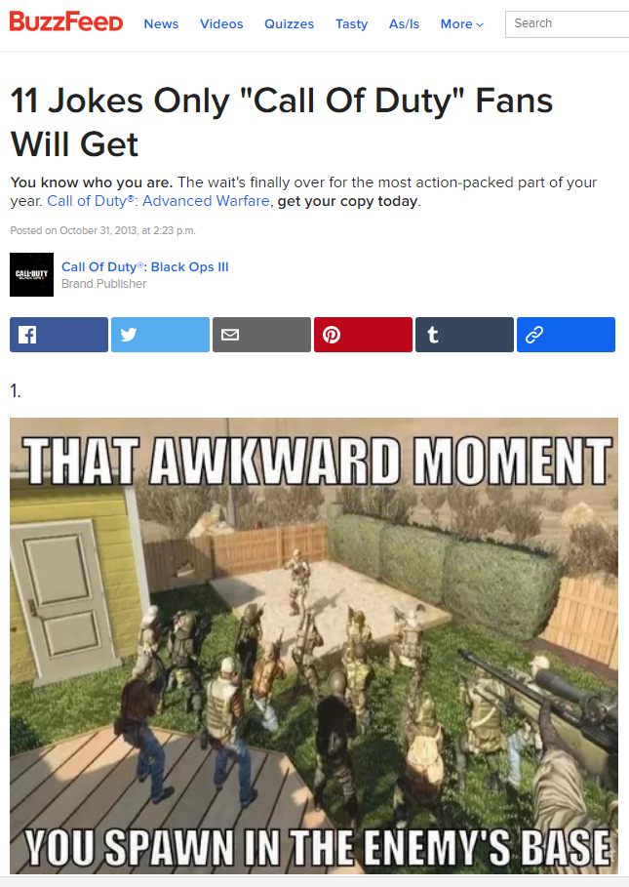
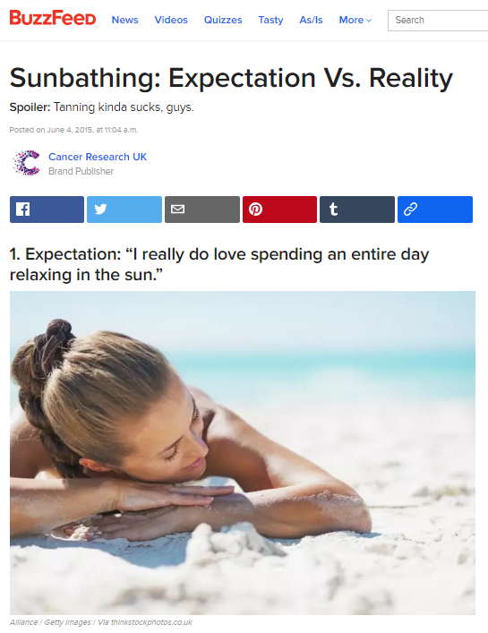

Slide 28
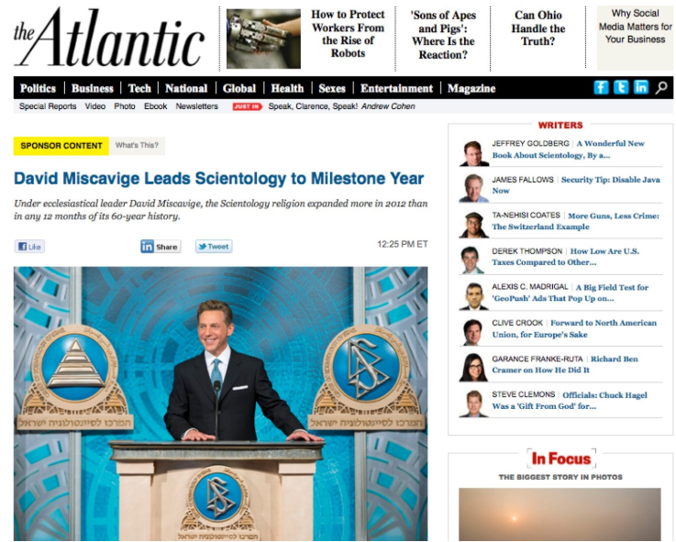
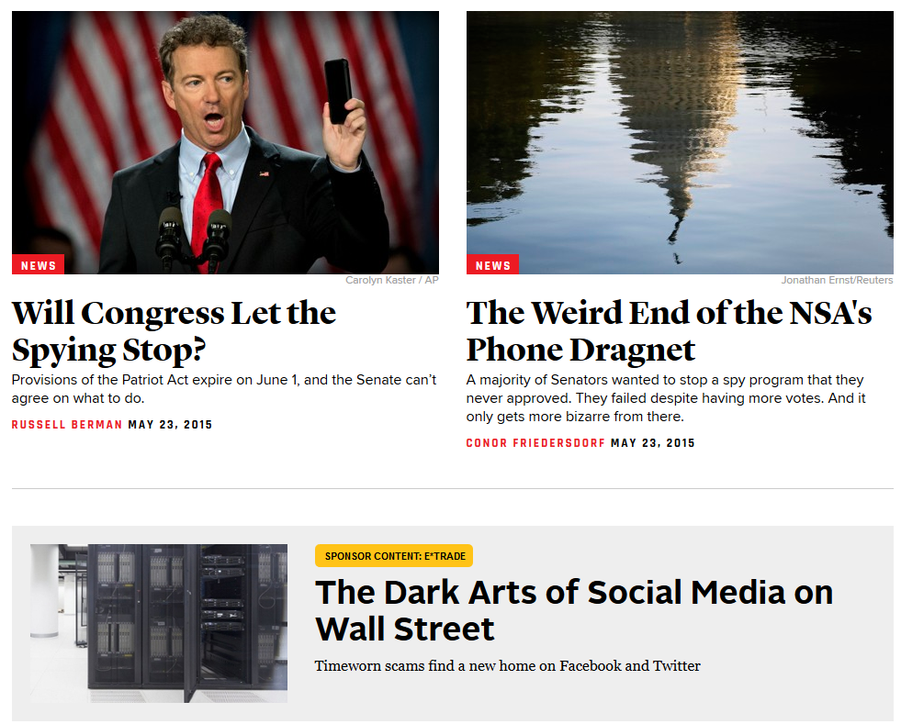
From The Atlantic

Slide 29
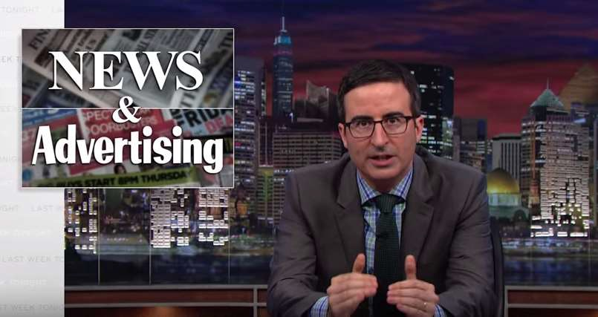
Native Advertising
Note: “Separation of Church and State” in journalistic context =
Separation of editorial and advertising
https://youtu.be/E_F5GxCwizc?t=3m5s
(content note, some profanity [semi-censored])

Slide 30

What should we do about it?
Consequences?
The clear effects of a given regulation on a society at large
Contingencies?
The socio-cultural/historical factors at play during the creation of a regulation

Slide 31
Example: Regulating media content
Climate Change

Slide 32
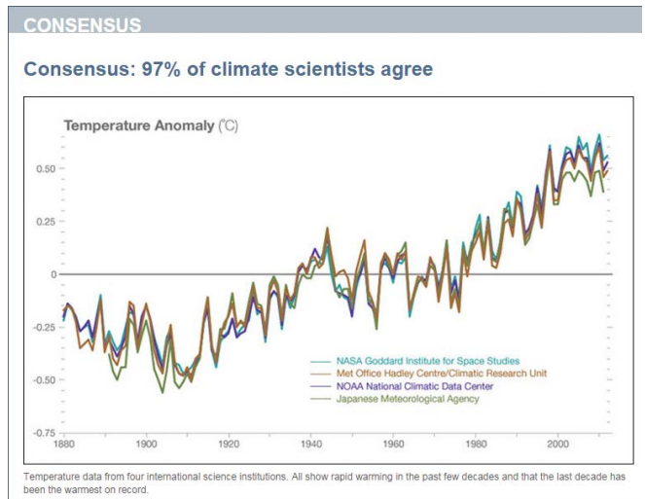
Scientific consensus
http://climate.nasa.gov/evidence/

Slide 33
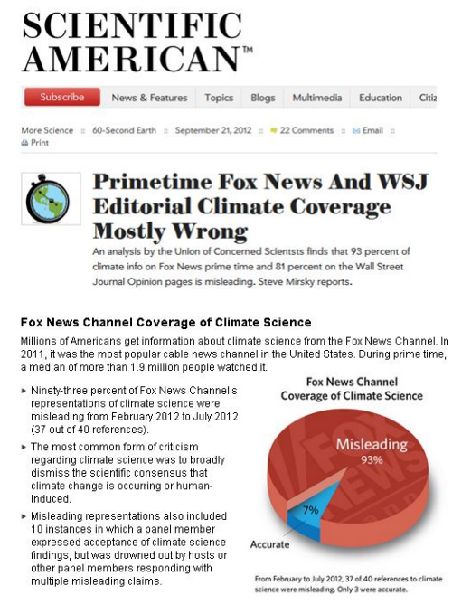

A History of Silencing
http://www.scientificamerican.com/podcast/episode.cfm?id=primetime-fox-news-and-wsj-editoria-12-09-21

Slide 34


Slide 35
What should we do about it?

Slide 36
Regulating media ownership
Monopoly, national interest, intellectual property

Slide 37
Regulating media ownership
What are some of the pragmatic considerations?
Combating media monopoly

Slide 38
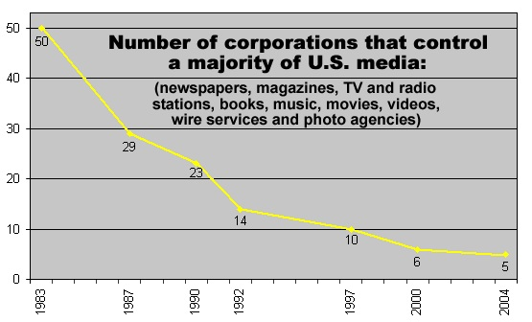
Source: Media Reform Information Center
http://www.corporations.org/media/

Slide 39
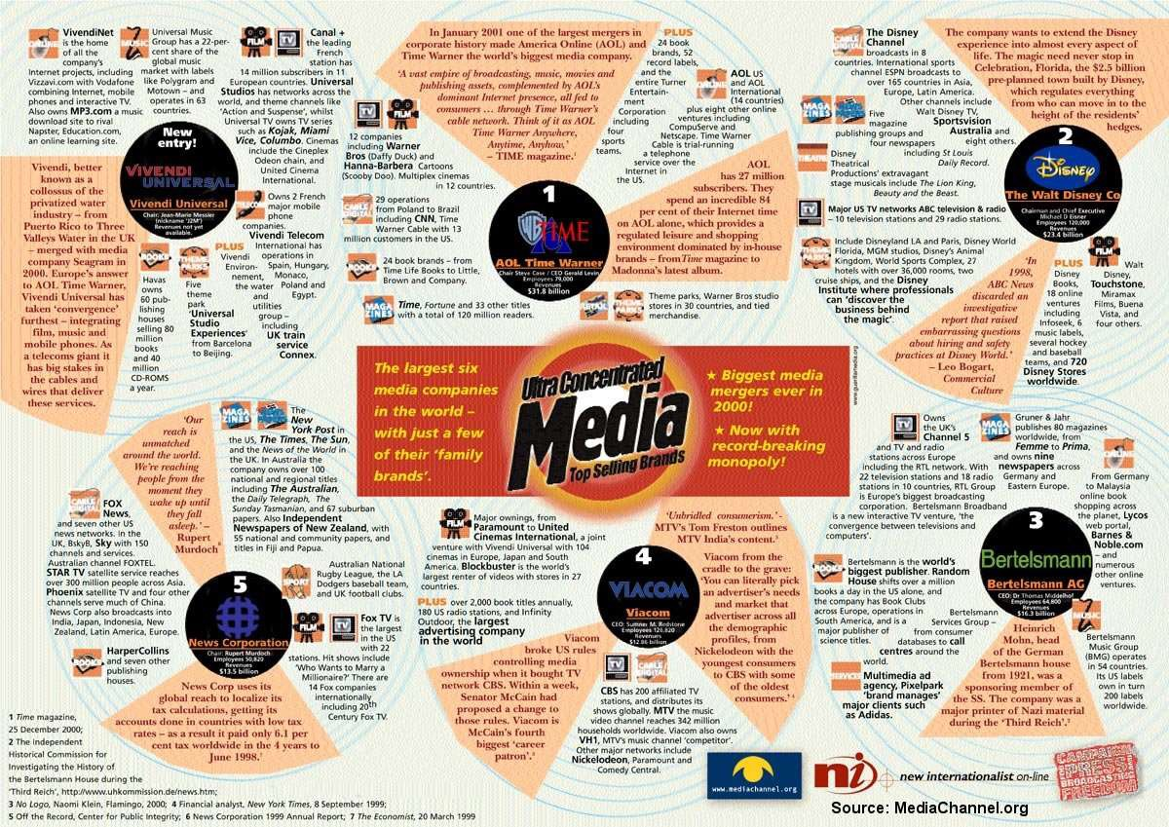
Source: Media Channel, http://www.mediachannel.org/

Slide 40
Recall, Marxist analysis – the “big six”
 | Print media | Film and sound | TV and radio | New media
The Walt Disney Company (Robert A. Iger, CEO) | Disney Press, Hyperion Books, Voice, Marvel Publishing, ESPN The Magazine | Walt Disney Pictures, Marvel Studios, Pixar Animation, Lucasfilm Ltd., Touchstone Pictures, Walt Disney Records | ABC Family, Disney Channel, Disney Junior, SOAPnet, A&E (50%), ESPN (80%), Lifetime (50%), HISTORY (50%) | ABC.com, Disney.com, ESPN3, WatchESPN, DisneyBaby.com, Go.com, Hulu (32%), Disney Interactive Games
Time Warner (Jeffrey Bewkes, CEO) | Warner Books, DC Comics, People, Time, Sports Illustrated, Entertainment Weekly, InStyle, Fortune | Warner Brothers Pictures, New Line Cinema, Castle Rock, DC Entertainment | CNN, TBS, TNT, Cartoon Network, truTV, Turner Classic Movies, Adult Swim, HLN, HBO, Cinemax, The CW (50%) | CNN.com, DCComics.com, TMZ.com, KidsWB.com, NBA.com, NCAA.com, PGA.com
News Corp (Rupert Murdoch, CEO) | HarperCollins, Zondervan, Dow Jones, Wall Street Journal, Barron’s, New York Post | Twentieth Century Fox, Fox 2000 Pictures, Fox Searchlight Pictures, Fox Music, Blue Sky Studios | FOX, FOX News FX, FUEL TV, SPEED, FSN, National Geographic Channel (70%) | FOX.com, Amplify, IGN Entertainment, AskMen, Making Fun, Wireless Generation, Hulu (32%)
Viacom (Philippe Dauman, CEO) | (Viacom has not owned any print media since its split with CBS in December 2005) | Paramount Pictures, Paramount Vintage, MTV Films, Insurge Pictures, Nickelodeon Movies | MTV, VH1, CMT, Nickelodeon, Nick Jr., Nick at Nite, Comedy Central, SPIKE, TV Land, BET | ParentsConnect,GoCityKids, Atom Entertainment, Shockwave, Nick.com, GameTrailers
CBS Corporation (Leslie Moonves, CEO) | Simon & Schuster, Pocket Books, Scribner, The Free Press | CBS Films | CBS, Showtime, The CW (50%), The Movie Channel, FLIX, CBS Radio | CBS Interactive, CBSSports.com, Last.fm, CNET
Comcast (Brian L. Roberts, CEO) | (Comcast does not currently own any print media) | Focus Features, Universal Pictures, Universal Home Entertainment | NBC, MNBC, E!, USA Network, Bravo, Oxygen, Golf Channel, Syfy, CNBC, Chiller, G4, Telemundo, The Weather Channel Companies | Fandango, DailyCandy, Television Without Pity, iVillage, CNBC Digital, Plaxo, NBC.com, Hulu (32%), Comcast Interactive Media

Slide 41
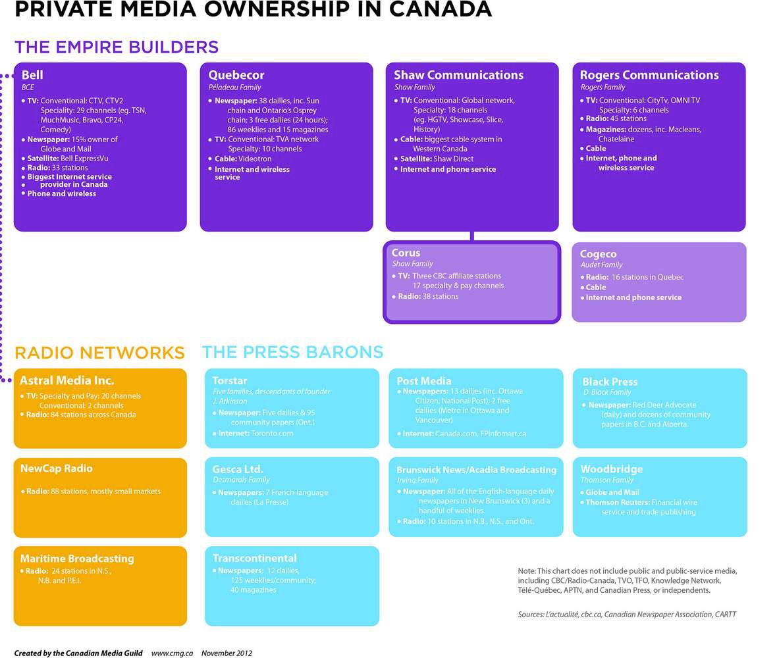

Slide 42
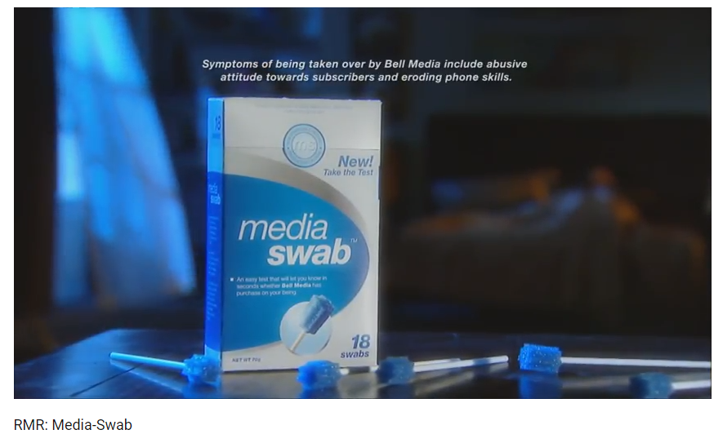
http://www.youtube.com/watch?v=y_7-XZb9s2Y

Slide 43

What should we do about it?

Slide 44
Regulating media ownership
What are some of the pragmatic considerations?
Combating media monopoly
Maintaining national interest (Canadian Content Laws)

Slide 45
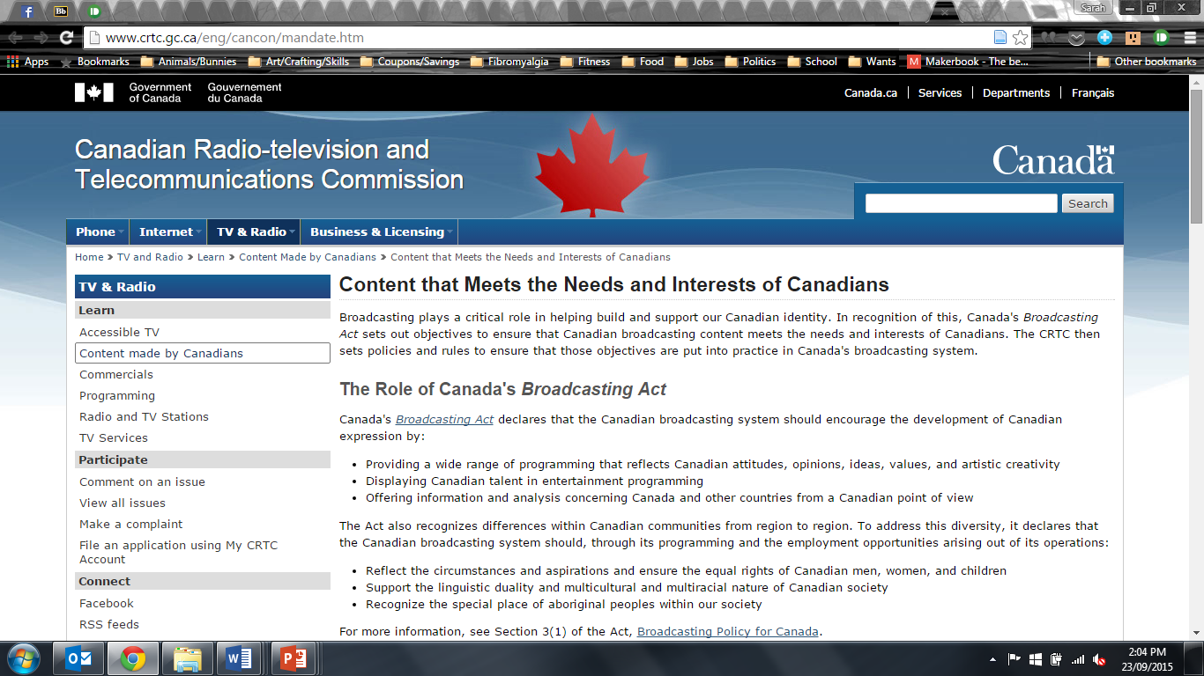
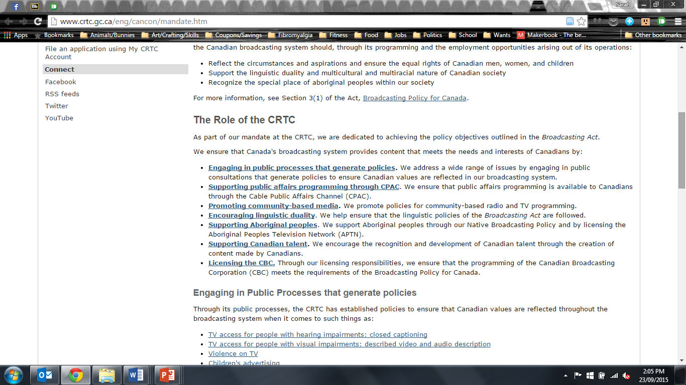
http://www.crtc.gc.ca/eng/cancon/mandate.htm

Slide 46
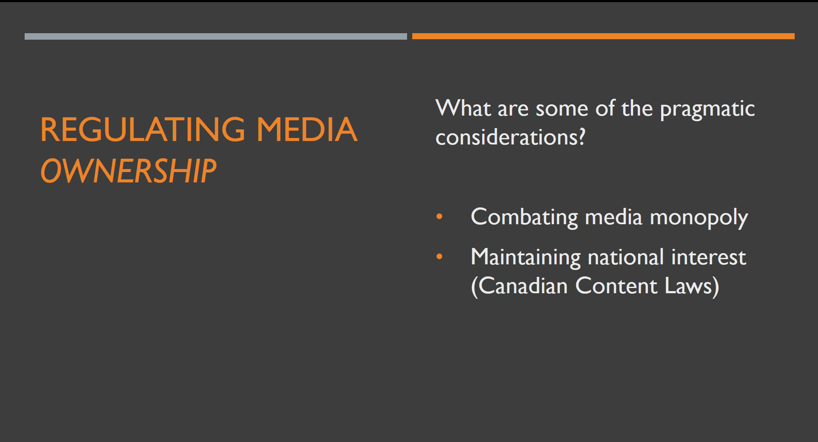
Protecting Intellectual Property (Copyright Laws)

Slide 47

Intellectual Property: Who owns what? What constitutes “fair use”?
http://www.cipo.ic.gc.ca/eic/site/cipointernet-internetopic.nsf/eng/h_wr00003.html?OpenDocument

Slide 48

“The common good is a meme that was overwhelmed by intellectual property. It needs to spread again.”

Slide 49

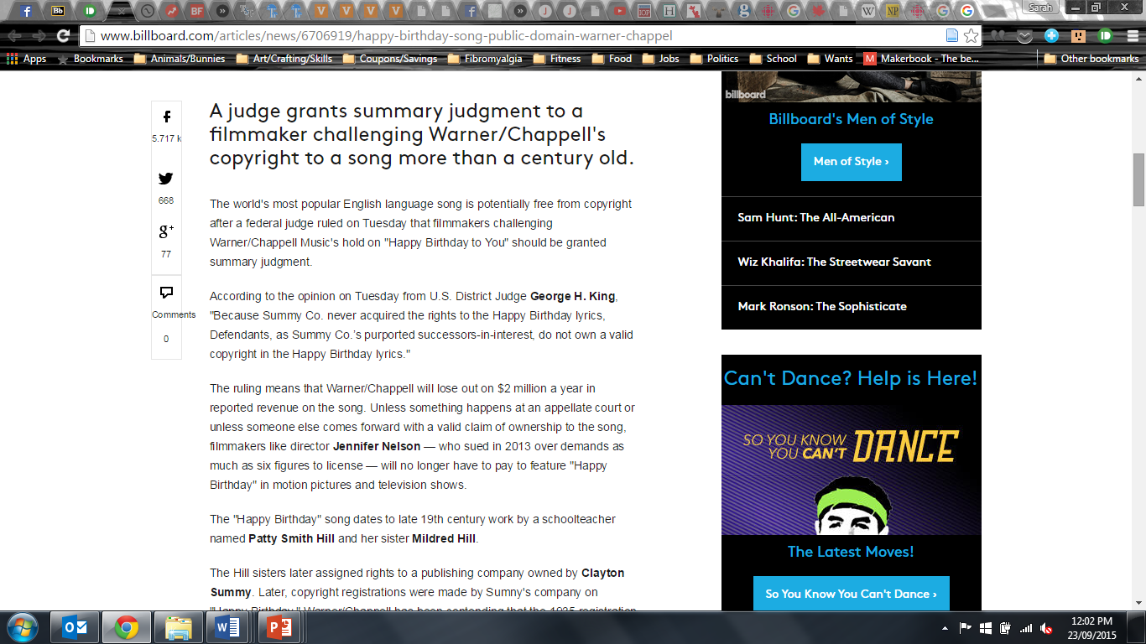
http://www.billboard.com/articles/news/6706919/happy-birthday-song-public-domain-warner-chappel

Slide 50
Regulating media content
Diversity, morality, accuracy

Slide 51
Regulating media content
Promoting Diversity
Fairness Doctrine
Equal Time Act
Managing Morality
Obscenity – sexually-explicit material
Indecency – material unfit for general broadcast
Profanity – “foul” language
Ensuring Accuracy
Fraudulent Claims
Defamation – libel (print) & slander (spoken)
The “7 Dirty Words” – George Carlin
http://en.wikipedia.org/wiki/Seven_dirty_words
http://www.youtube.com/watch?v=dxR4RpPL1rc

Slide 52

Managing morality: Media self-regulation
Music – Music Canada (formerly CRIA)
https://en.wikipedia.org/wiki/Music_Canada

Slide 53
Media self-regulation
Music – Music Canada (formerly CRIA)
https://en.wikipedia.org/wiki/Music_Canada
Film – MPAA (Motion Picture Association of America)
http://www.mpaa.org/film-ratings/
http://en.wikipedia.org/wiki/Canadian_motion_picture_rating_system

Slide 54

Canadian Movie Rating System
G - General Audience - Suitable for all ages.
PG - Parental Guidance - Parental guidance advised. There is no age restriction but some material may not be suitable for all children.
14A - 14 Accompaniment - Persons under 14 years of age must be accompanied by an adult.
18A - 18 Accompaniment - Persons under 18 years of age must be accompanied by an adult. In the Maritimes and Manitoba, children under the age of 14 are prohibited from viewing the film.
R - Restricted - Admittance restricted to people 18 years of age or older.
A - Adult - Admittance restricted to people 18 years of age or older. Sole purpose of the film is the portrayal of sexually explicit activity and/or explicit violence.

Slide 55
Media self-regulation
Music – Music Canada (formerly CRIA)
https://en.wikipedia.org/wiki/Music_Canada
Film – MPAA (Motion Picture Association of America)
http://www.mpaa.org/film-ratings/
http://en.wikipedia.org/wiki/Canadian_motion_picture_rating_system
TV – CBSC (Canadian Broadcast Standards Council)
http://www.cbsc.ca/english/agvot/englishsystem.php

Slide 56

G – Suitable for general audiences. Programming suitable for the entire family with mild violence, and mild profanity and/or censored language.
C – Programming suitable for children ages of 2–7 years. No profanity or sexual content of any level allowed. Contains little violence.
C8 – Suitable for children ages 8+. Low level violence and fantasy horror is allowed. No foul language is allowed, but occasional "socially offensive and discriminatory" language is allowed if in the context of the story. No sexual content of any level allowed.
PG – Parental guidance. Moderate violence and moderate profanity is allowed, as is brief nudity and sexual references if important to the context of the story.
14+ – Programming intended for viewers ages 14 and older. May contain strong violence and strong profanity, and depictions of sexual activity as long as they are within the context of a story.
18+ – Programming intended for viewers ages 18 and older. May contain explicit violence and sexual activity. Programming with this rating cannot air before the watershed(9:00 p.m. to 6:00 a.m.).
Exempt – Shows which are exempt from ratings (such as news and sports programming) will not display an on-screen rating at all.

Slide 57
Media self-regulation
Music – Music Canada (formerly CRIA)
https://en.wikipedia.org/wiki/Music_Canada
Film – MPAA (Motion Picture Association of America)
http://www.mpaa.org/film-ratings/
http://en.wikipedia.org/wiki/Canadian_motion_picture_rating_system
TV – CBSC (Canadian Broadcast Standards Council)
http://en.wikipedia.org/wiki/Television_content_rating_systems#Canada
Video Games – Entertainment Software Rating Board (ESRB)
http://www.esrb.org/

Slide 58


Slide 59
Violence in Media
MDSa01 Lectures are Rated: TV – MA
L = crude indecent language
V = graphic violence

Slide 60
Issues: Violence in Media
Trends in the violent crime rate
Violent crime rate steadily dropped until 2000 (lowest in 15 years), then slightly rose through 2006 before falling again
Ubiquity of violence in the media
Media industry aggressively markets violent programming toward children
Research on effects of violent media is “mixed”

Slide 61
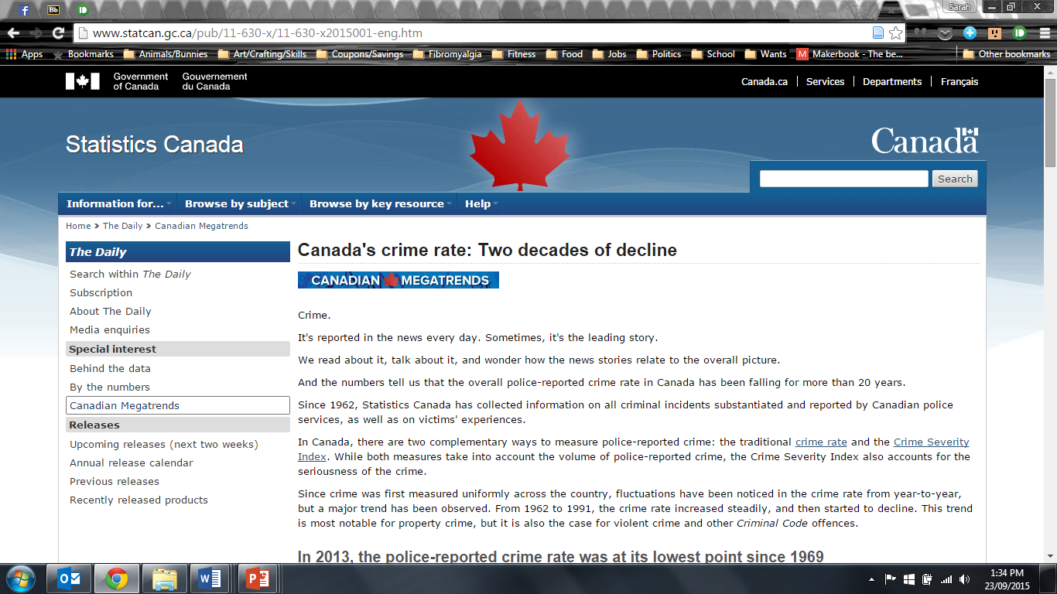
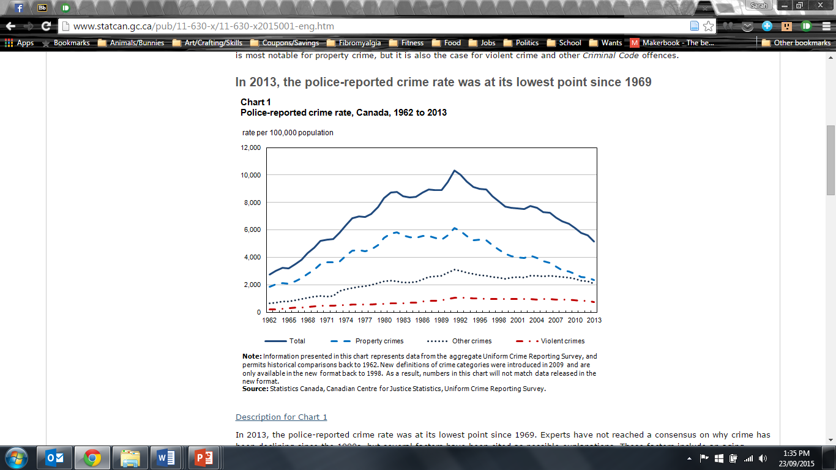
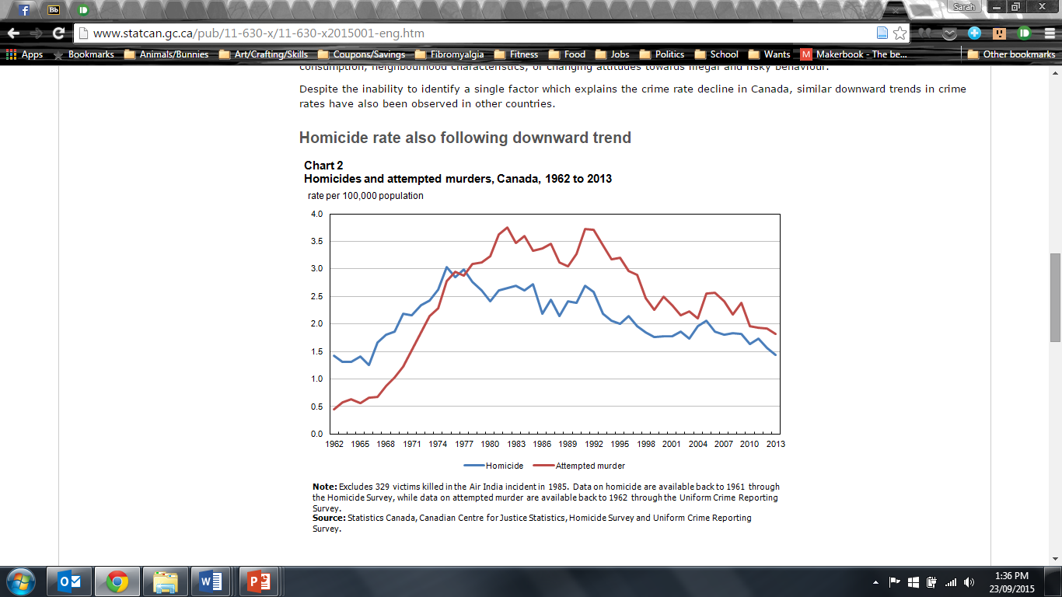
http://www.statcan.gc.ca/pub/11-630-x/11-630-x2015001-eng.htm

Slide 62
Giroux’s categories of media Violence
Historical or reflective

Slide 63
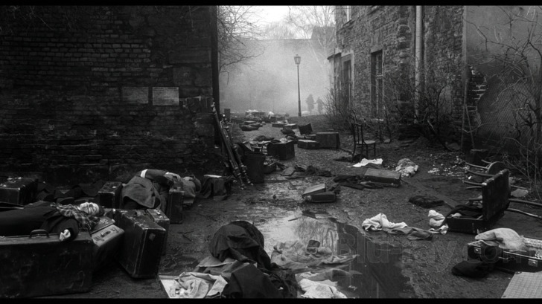
Historical (Reflective) Violence
Schindler's List
Characteristics:
Historical
Realistic
Solemn and serious
Elicits empathy and emotional affect
Invites reflection and contemplation
Heightens social consciousness

Slide 64
Giroux’s categories of media Violence
Historical or reflective
Ritualistic or gore

Slide 65
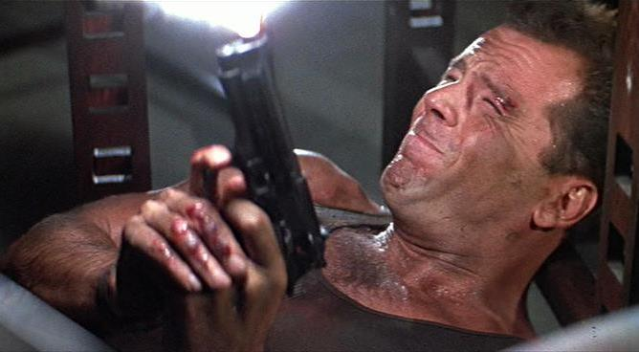
Ritualistic Violence (Gore)
Characteristics
Die Hard
Ritualistic/formulaic
Sensational/thrilling
Playful and humorous
Fast-paced and adrenaline-pumping
Identification with hyper-masculine hero
Stimulates and entertains

Slide 66
Giroux’s categories of media Violence
Historical or reflective
Ritualistic or gore
Hyper-real or stylized

Slide 67

Hyper-Real (Stylized) Violence
Characteristics
Pulp Fiction
Artistic
Hyper-realistic
Ironic and hip
Gritty dialogue and dramatic storytelling
Invites involvement
Generates a cool detachment

Slide 68
Social effects of Media Violence
Aggressor effect – arousal, disinhibition, imitation, mimicry
Disinhibition
Enculturation
Victim effect – heightened fearfulness of violence
Mainstreaming
Bystander effect – insensitivity toward violent acts
Desensitization
Catharsis effect – can reduce and alleviate feelings of aggression

Slide 69
Mitigating factors
Situational-environmental factors
Salience of display
Family environment
Behavior of others present at viewing
Individual characteristics

Slide 70

What should we do about it?
Consequences?
Contingencies?

Slide 72
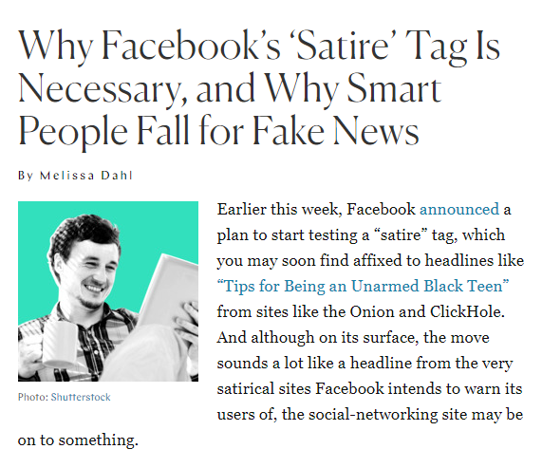
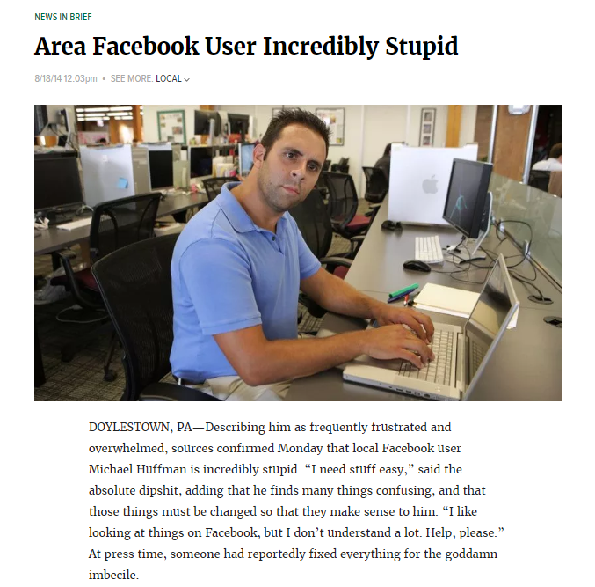
https://www.thecut.com/2014/08/why-facebooks-satire-tag-is-necessary.html
https://local.theonion.com/area-facebook-user-incredibly-stupid-1819576827

